Slide 1


Generative Adversarial Network (GAN)

Slide 2
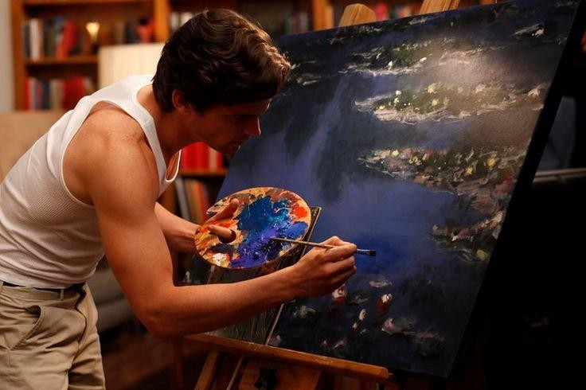
Train an artificial author which can write an article and explain data science concepts to a community in a very simplistic manner by learning from past articles on Analytics Vidhya
You are not able to buy a painting from a famous painter which might be too expensive. Can you create an artificial painter which can paint like any famous artist by learning from his
/ her past collections?

Slide 3
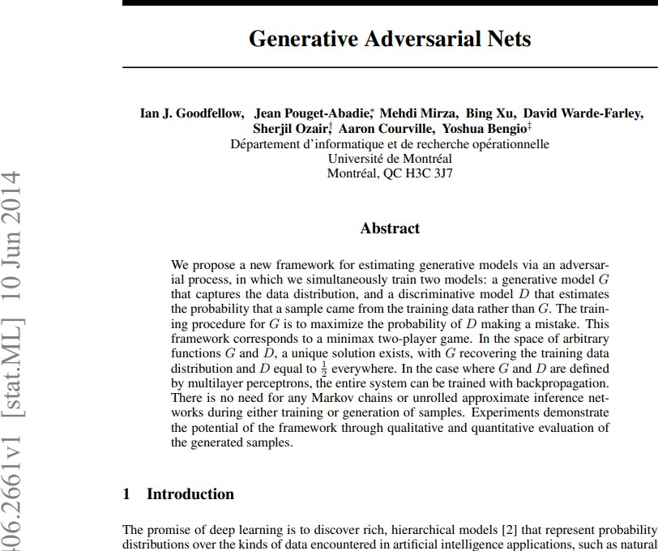
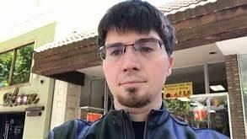
(GANs), and the variations that are now being proposed is the most interesting idea in the last 10 years in ML, in my opinion.” – Yann Lecun

Slide 4
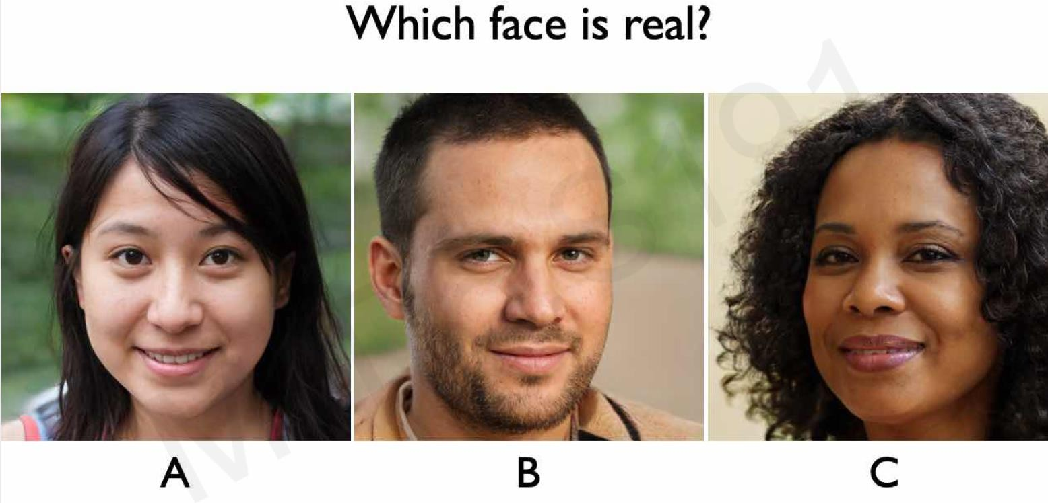

Slide 5

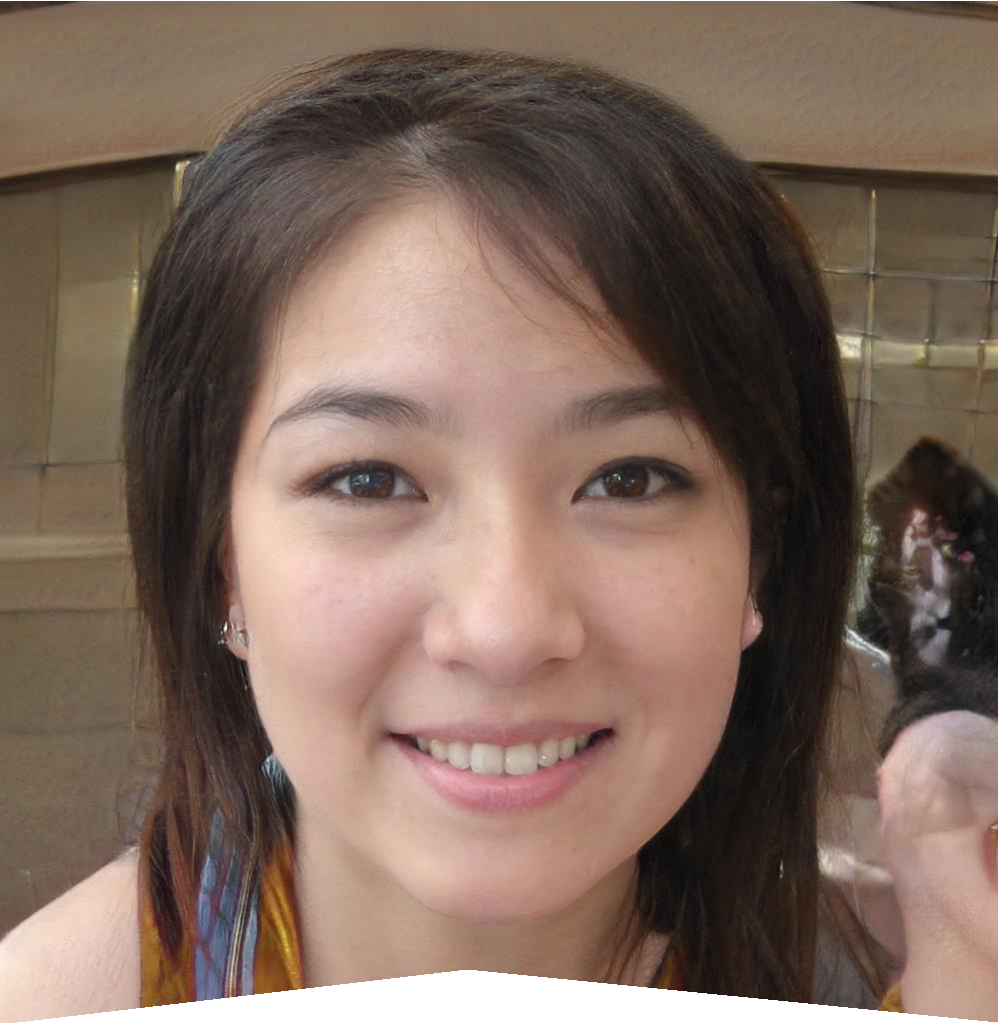
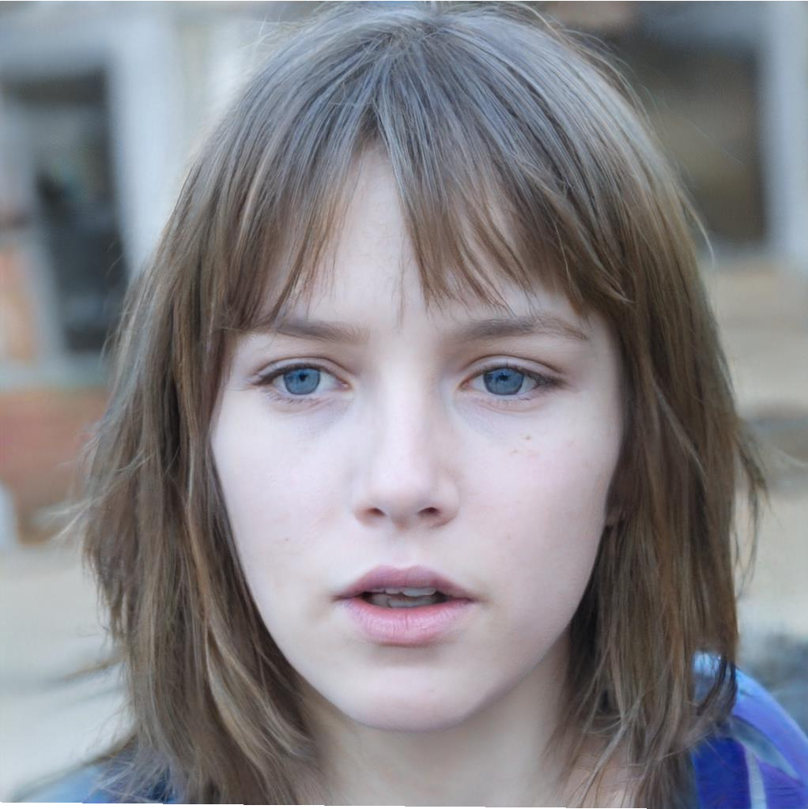

Slide 6
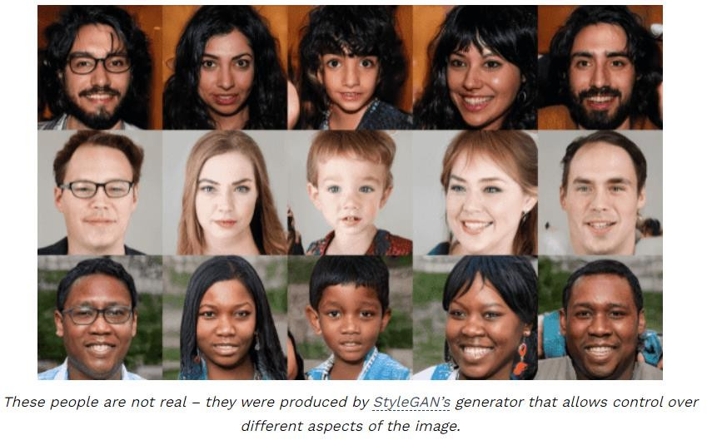
Deepfakes?-Face synthesis with GANs and Autoencoders
Deepfakes are synthetic media in which a person in an existing image or video is replaced with someone else's likeness
facial manipulation using
Face synthesis ( StyleGAN)
Face swap
Facial attributes and expression
Generating realistic-looking images that even a human can’t recognize whether it’s real or not

Slide 7
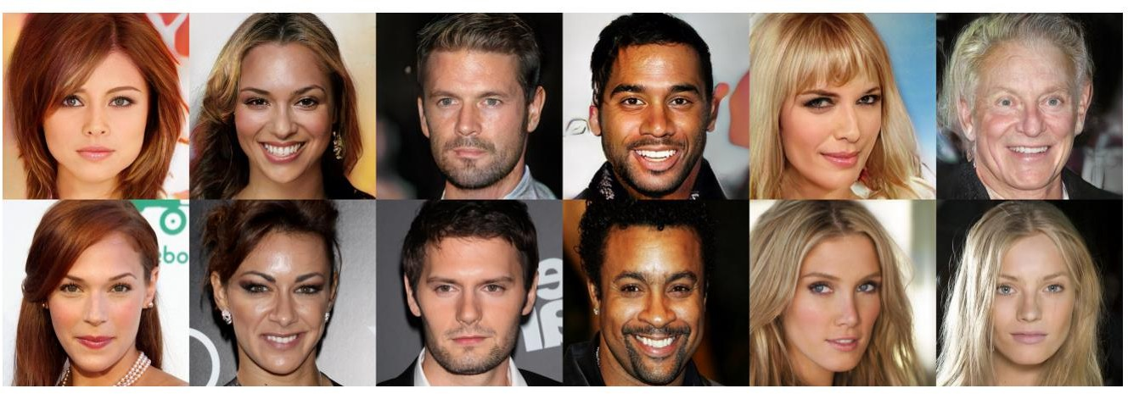
Closest Real Images

Slide 8
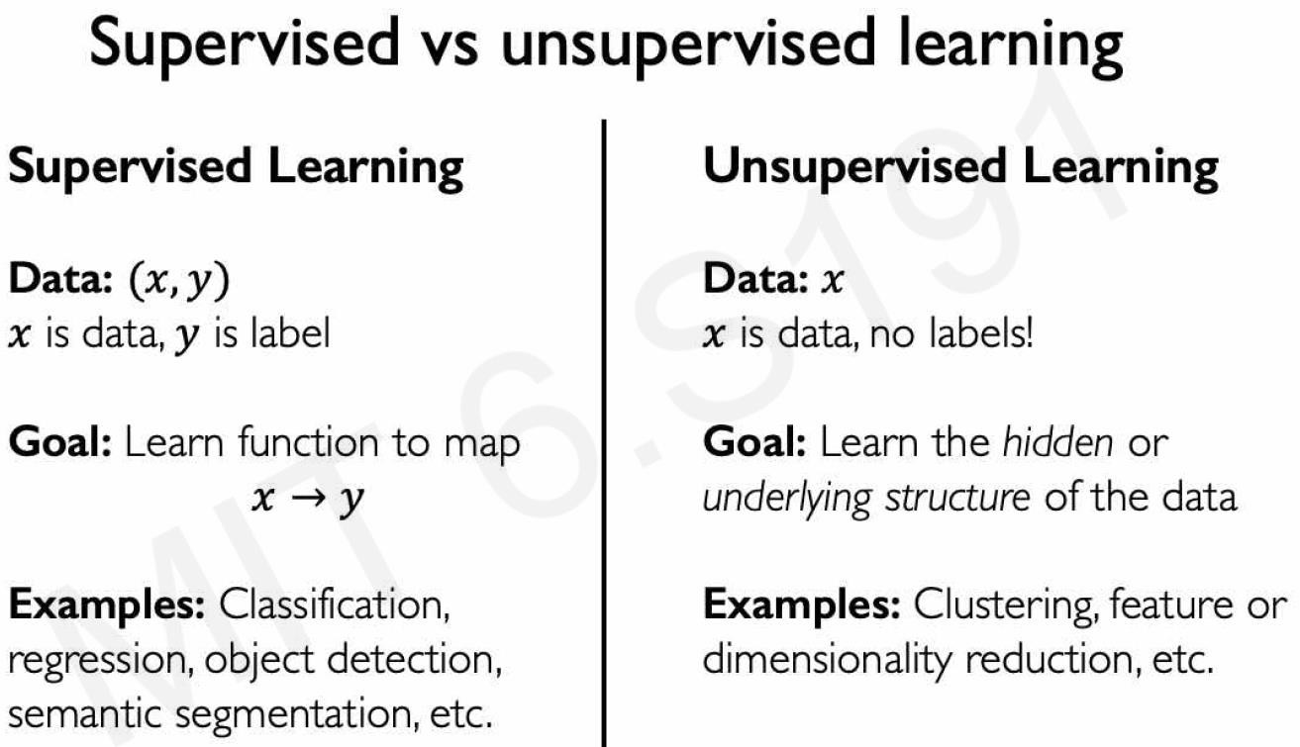

Slide 9
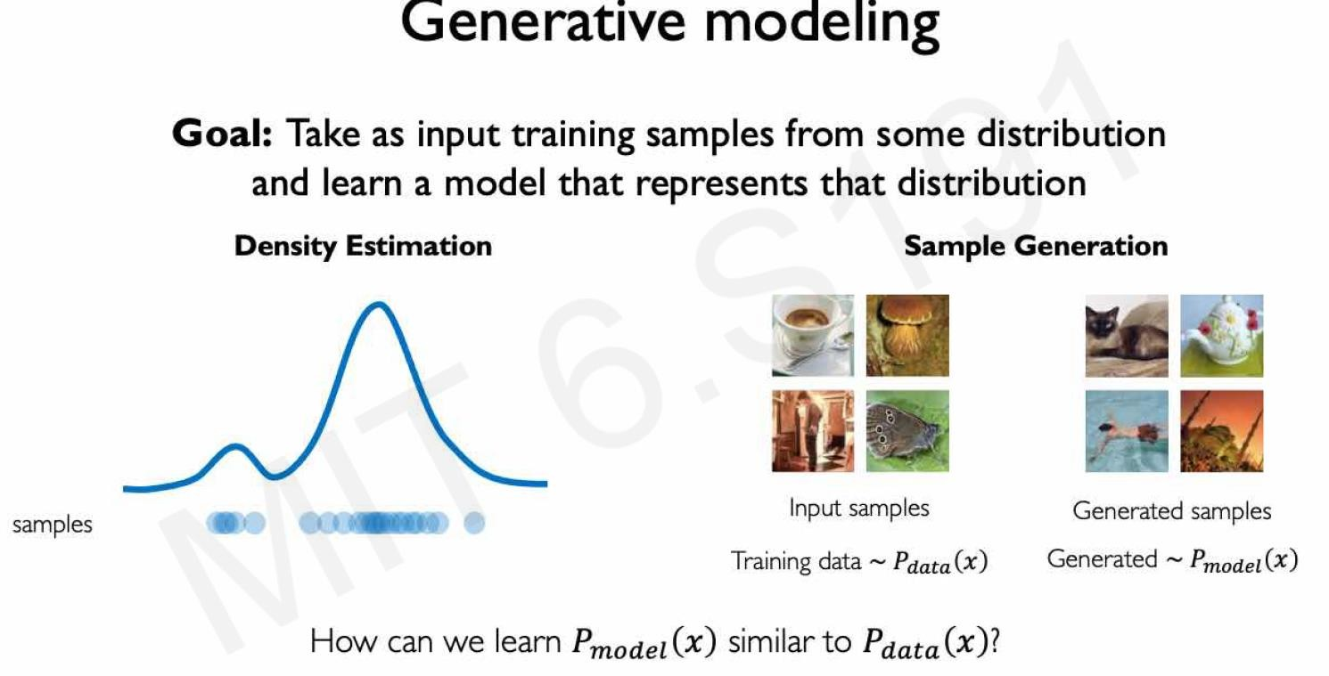

Slide 10
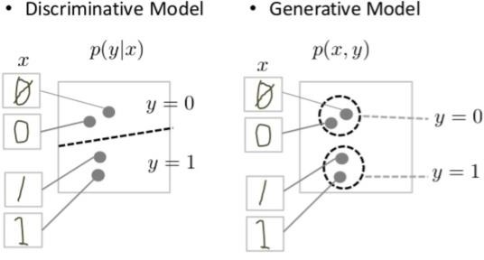
GANs are just one kind of generative model. More formally, given a set of data instances X and a set of labels Y: Generative models capture the joint probability p(X, Y), or just p(X) if there are no labels. Discriminative models capture the conditional probability p(Y | X).

Slide 11
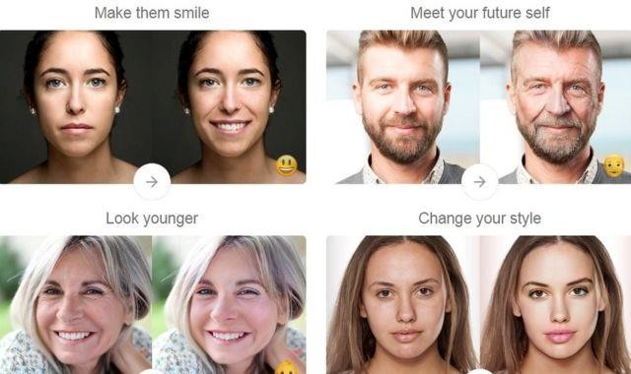
FaceApp
FaceApp. The viral Russian app, FaceApp which automatically
generates highly realistic transformations of your face

Slide 12
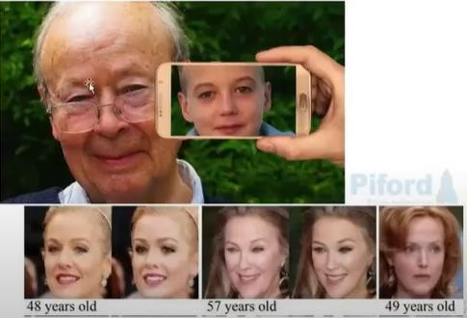
Face de-aging

Slide 13
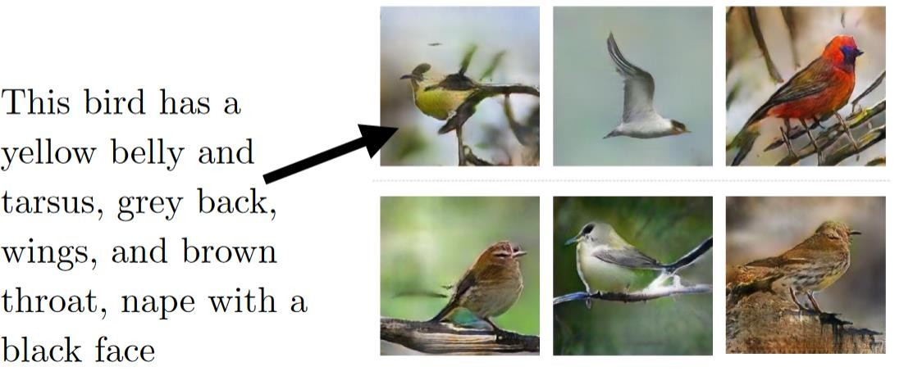
Text to Image Generation
Text to Image Generation : Just say to your GAN what you want to see and get a realistic photo of the
target.

Slide 14
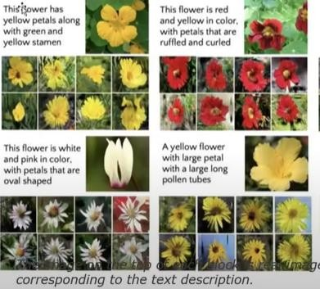
Text to Image Translation
StackGAN: Text to Photo- realistic Image Synthesis

Slide 15
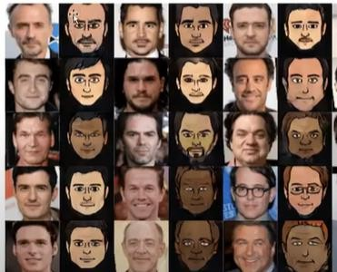
Photos to Emojis
XGAN tremendously successful in generating fun cartoon avatar directly from photos

Slide 16
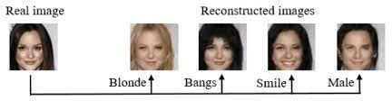
Image Editing
invertible Conditional GANs for image editing
Guim Perarnau, Joost van de Weijer, Bogdan Raducanu, Jose M. Álvarez

Slide 17
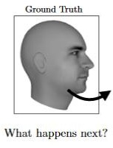
Predicting the next frame in a video : You train a GAN on video sequences and let it predict what would occur next

Slide 18
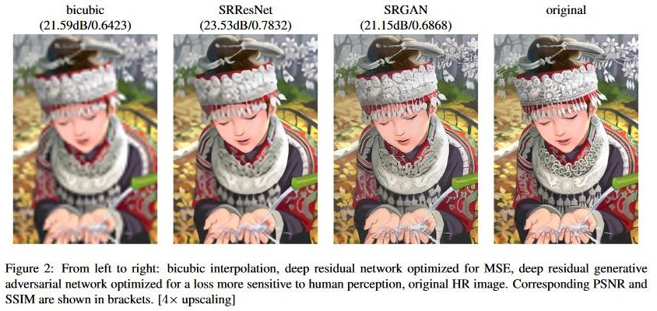
Increasing Resolution of an image : Generate a high resolution photo from a comparatively low resolution.

Slide 19
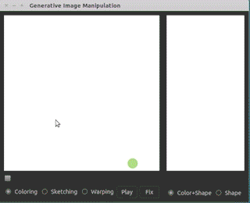
Interactive Image Generation : Draw simple strokes and let the GAN draw an impressive picture for you!

Slide 20
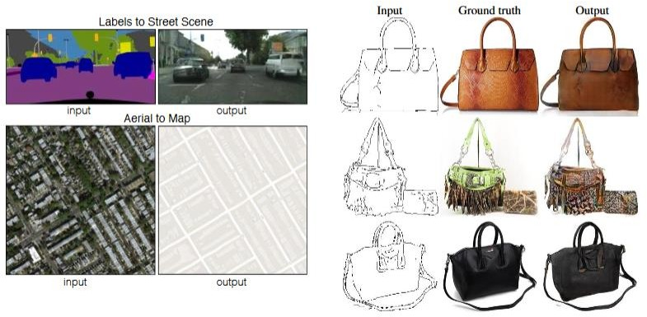
Image to Image Translation
: Generate an image from another image. For example, given on the left, you have labels of a street scene and you can generate a real looking photo with GAN. On the right, you give a simple drawing of a handbag and you get a real looking drawing of a handbag.

Slide 21
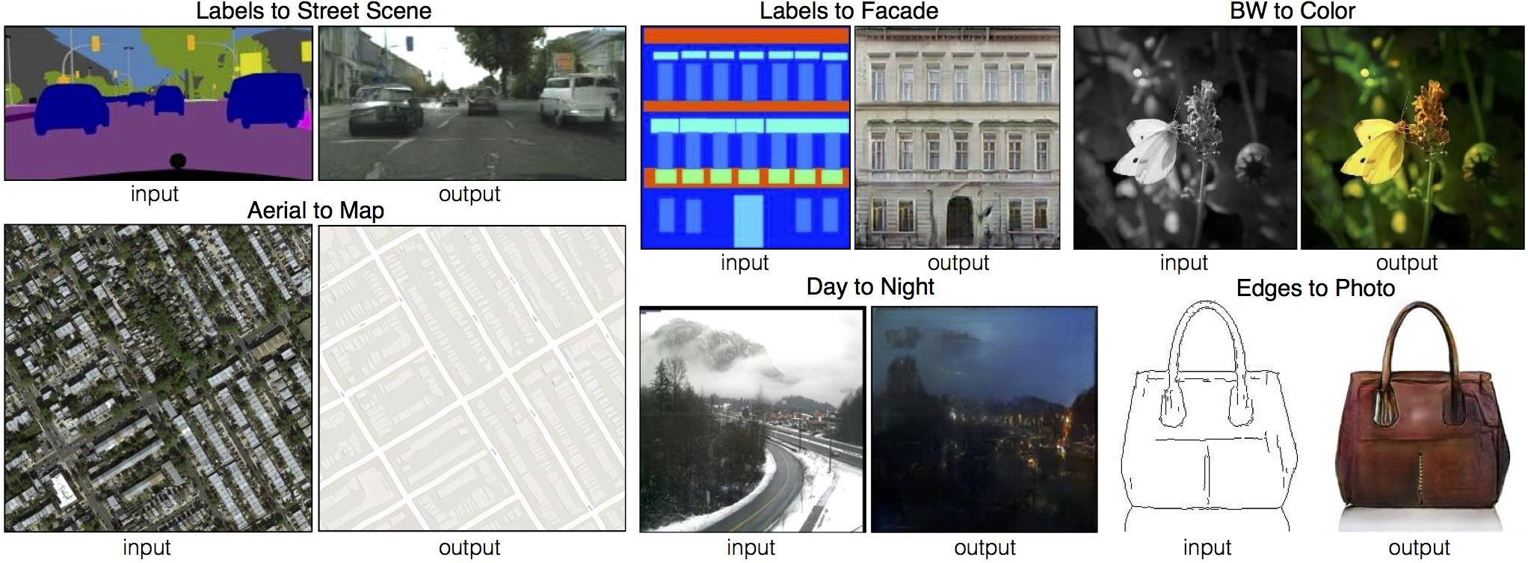
Pix2Pix GAN Image-to-image translation with conditional adversarial networks

Slide 22
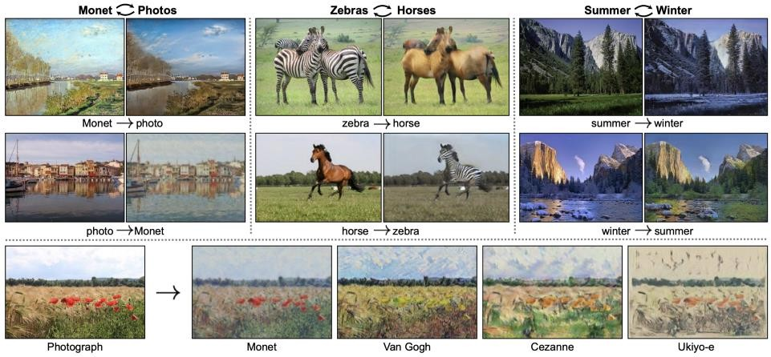
Image to image Translation (Cycle GAN)

Slide 23

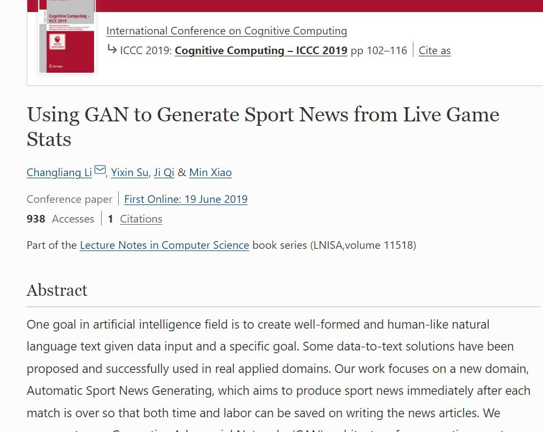
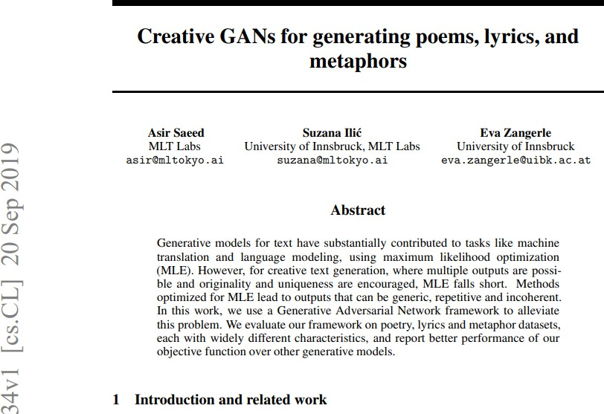
Creative GANs for generation, of text, music poerty, lyrics, metaphors
MuseGAN: Using GANs to generate original Music

Slide 24
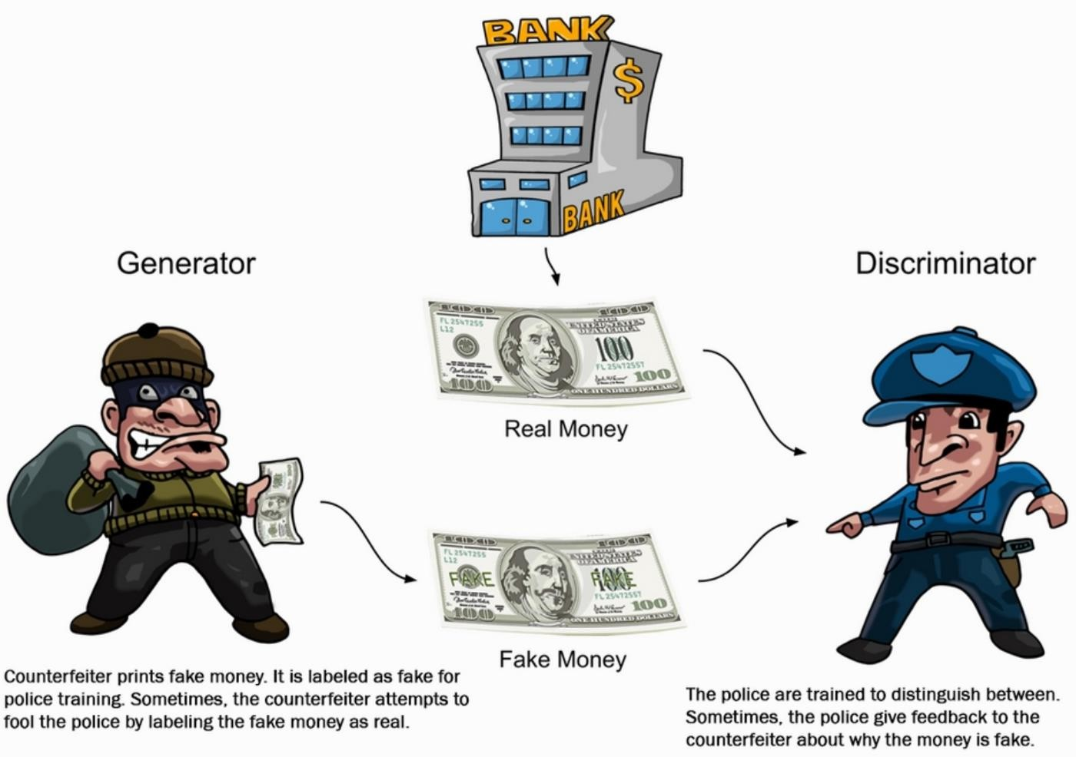
How GAN works?

Slide 25
Generative Adversarial Networks(GAN in short) is an advancement in the field of Machine Learning which is capable of generating new data samples including Text, Audio, Images, Videos, etc. using previously available data.
How does GAN Work?
GANs consists of two ANN or CNN models:
Generator Model: Used to generate new images which look like real images.
Discriminator Model: Used to classify images as real or
fake.
Simply, for getting a powerful hero (generator), we need a more powerful opponent (discriminator)!

Slide 26
The Generator Model
The Generator Model generates new images by taking a fixed size random noise as an input. Generated images are then fed to the Discriminator Model.
The main goal of the Generator is to fool the Discriminator by generating images that look like real images and thus makes it harder for the Discriminator to classify images as real or fake.
The Discriminator Model
The Discriminator Model takes an image as an input (generated and real) and classifies it as real or fake. Generated images come from the Generator and the real images come from the training data.
The discriminator model is the simple binary classification model.

Slide 27
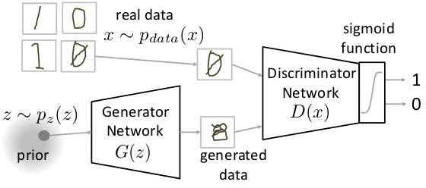

Slide 28
The Generator Model G takes a random input vector z as an input and generates
the images G(z).
These generated images along with the real images x from training data are then fed to the Discriminator Model D.
The Discriminator Model then classifies the images as real or fake.
Then, we have to measure the loss and this loss has to be back propagated to update the weights of the Generator and the Discriminator.

Slide 29
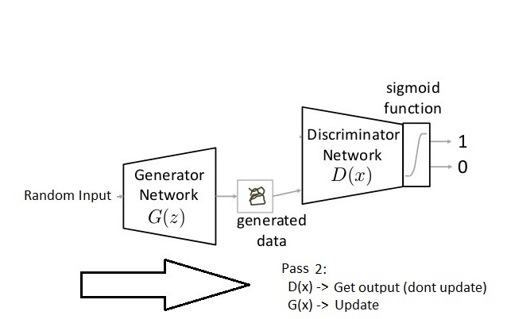
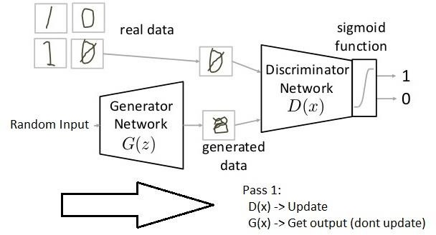
Steps of training
When we are training the Generator, we have to freeze the Discriminator and back propagate errors to only update the Generator.
When we are training the Discriminator, we have to freeze the Generator and back propagate errors to only update the Discriminator.

Slide 30
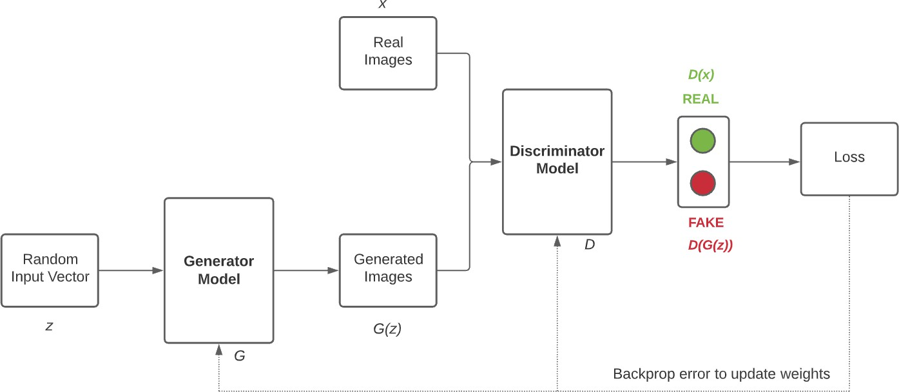
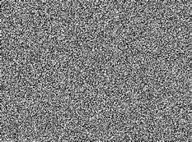

Slide 31
Steps to train GAN
Step 1: Define the problem. Do you want to generate fake images or fake text. Here you should completely define the problem and collect data for it.
Step 2: Define architecture of GAN. Define how your GAN should look like. Should both your generator and discriminator be multi layer perceptrons, or convolutional neural networks? This step will depend on what problem you are trying to solve.
Step 3: Train Discriminator on real data for n epochs. Get the data you want to generate fake on and train the discriminator to correctly predict them as real. Here value n can be any natural number between 1 and infinity. Step 4: Generate fake inputs for generator and train discriminator on fake data. Get generated data and let the discriminator correctly predict them as fake.
Step 5: Train generator with the output of discriminator. Now when the discriminator is trained, you can get its predictions and use it as an objective for training the generator. Train the generator to fool the discriminator.
Step 6: Repeat step 3 to step 5 for a few epochs.
Step 7: Check if the fake data manually if it seems legit. If it seems appropriate, stop training, else go to step 3

Slide 32
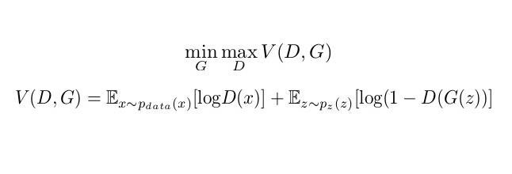
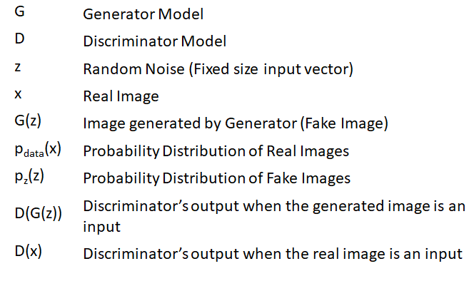
Loss Function of GAN
Discriminator output for real data
Discriminator output for Fake data
Generator wants to minimize the V(D, G) whereas
the Discriminator wants to maximize the V(D, G).
E_{x~pdata(x)} [log D(x)]: Average log probability of D when real image is input.
E_{z~pz(z)} [log(1 – D(G(z)))]: Average log probability of D
when the generated image is input.

Slide 33
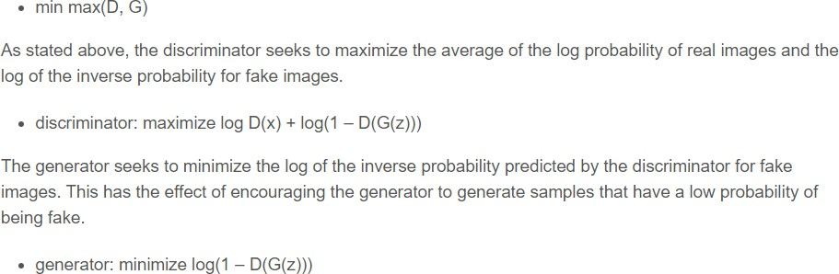
Min-max

Slide 34
Generator’s perspective
The Generator wants to minimize the loss function V(D, G) by generating images that look like real images and tries to fool the Discriminator.
The second term suggests that the Generator wants to make D(G(z)) as close to 1 (instead of 0) as possible and thus minimize the term eventually (1 – larger number will result in a smaller number). So that the Discriminator fails and misclassifies the images.
Discriminator’s perspective
The Discriminator wants to maximize the loss function V(D, G) by correctly classifying real and fake images.
The first term suggests that the Discriminator wants to make D(x) as close to 1 as possible, i.e. correctly classifying real images as real.
The second term suggests that the Discriminator wants to make D(G(x)) as close to 0 as possible, i.e. correctly classifying fake images as fake and thus maximize the term eventually (1 – smaller number will result in a larger number). Note: Probability lies in the range of 0-1.
Thus, The Generator tries to minimize the second term.
Thus, The Discriminator tries to maximize both the terms.

Slide 35
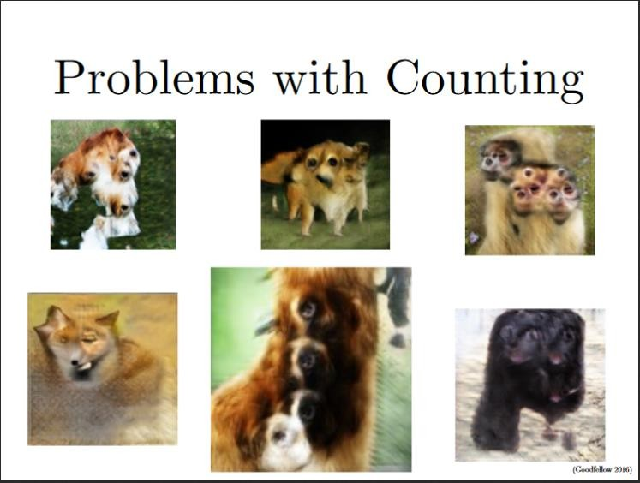
Challenges of GAN
Problem with Counting: GANs fail to differentiate how many of a particular object should occur at a location.

Slide 36
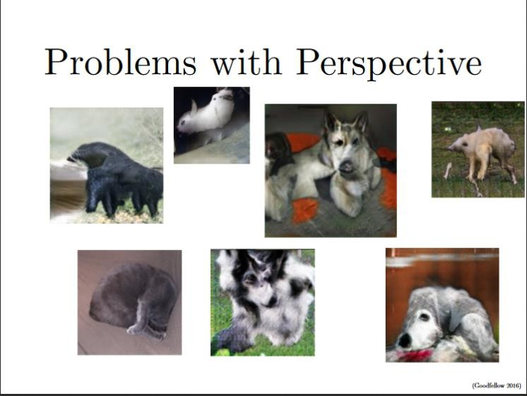
Challenges of GAN
Problems with Perspective: GANs fail to adapt to 3D objects. It doesn’t understand perspective, i.e.difference between frontview and backview.

Slide 37
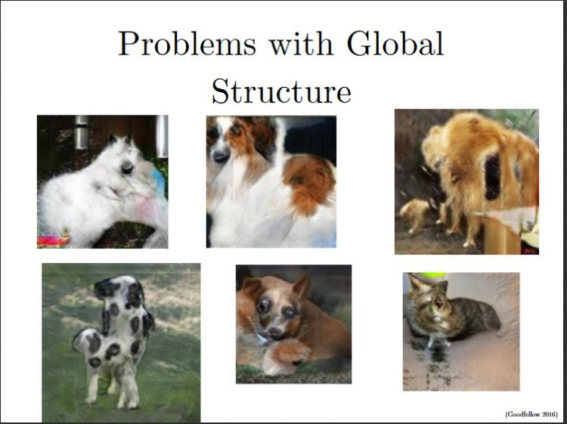
Challenges of GAN
Problems with Global Structures: Same as the problem with perspective, GANs do not understand a holistic structure. For example, in the bottom left image, it gives a generated image of a quadruple cow, i.e. a cow standing on its hind legs and simultaneously on all four legs. That is definitely not possible in real life!

Slide 38
